Slide 1
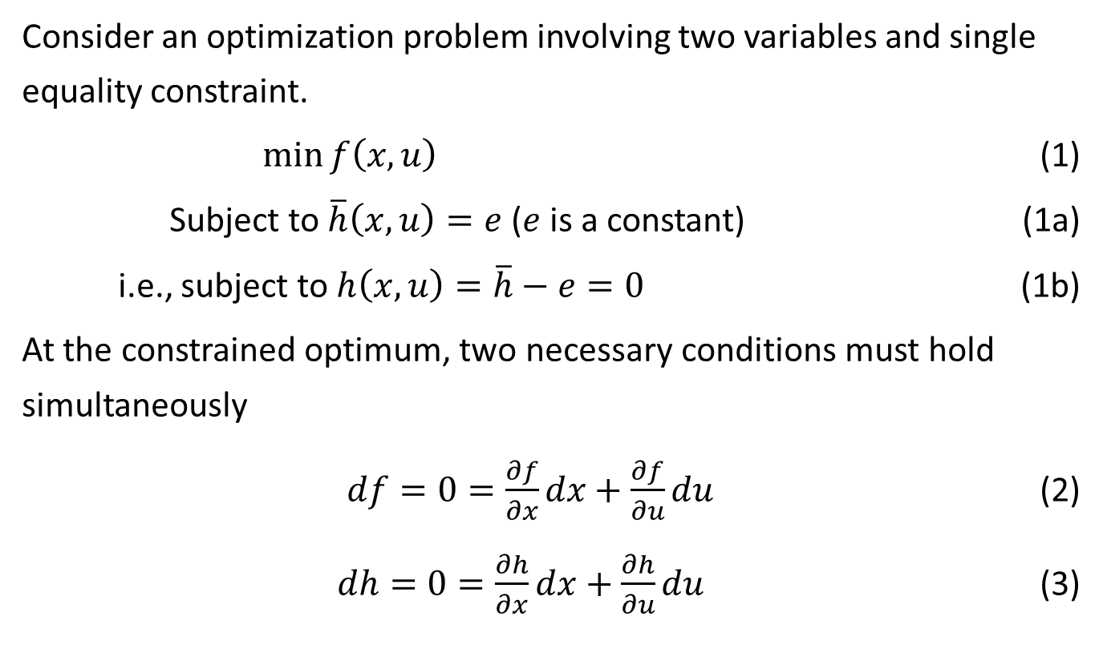
The Lagrange Multiplier Method
Consider an optimization problem involving two variables and single equality constraint.
$\min{f\left(x,u\right)}$ (1)
Subject to $\overline{h}\left(x,u\right)=e$ ($e$ is a constant) (1a)
i.e., subject to $h\left(x,u\right)=\overline{h}−e=0$ (1b)
At the constrained optimum, two necessary conditions must hold simultaneously
$df=0=\frac{∂f}{∂x}dx+\frac{∂f}{∂u}du$ (2)
$dh=0=\frac{∂h}{∂x}dx+\frac{∂h}{∂u}du$ (3)

Slide 2
$dx$ and $du$ are differential perturbations or variations from the optimum point $x^{∗}$ and $u^{∗}$
i.e., two equations in two unknown variables:
$a_{11}dx+a_{12}du=0$ (4a)
$a_{21}dx+a_{22}du=0$ (4b)
Because the right-hand side of both equations are 0, either a trivial solutions ($dx=du=0$) or a nontrivial (nonunique) solution can be chosen.
$\frac{a_{11}}{a_{21}}=\frac{a_{12}}{a_{22}}$ or $\frac{a_{11}}{a_{12}}=\frac{a_{21}}{a_{22}}$ (5)
Therefore, in general
$a_{11}=−λa_{21}$, $a_{12}=−λa_{22}$ (6)
where $λ$ is a Lagrange multiplier. An augmented objective function, called Lagrangian is defined as
$L\left(x,u,λ\right)=f\left(x,u\right)+λh\left(x,u\right)$ (note $h\left(x,u\right)=0$ )

Slide 3
So $L$ can be optimal as an equivalent unconstrained problem.
Eqn. (6) can be written in the following way (for two variables $x$ and $u$):
In addition to the above necessary conditions, the following equation must hold:
Also a sensitivity relationship is
(change in constraint)
$$\frac{∂f}{∂x}+λ\frac{∂h}{∂x}=\frac{∂L}{∂x}=0$$ | (7)
$$\frac{∂f}{∂u}+λ\frac{∂h}{∂u}=\frac{∂L}{∂u}=0$$ | (8)
$$\frac{∂L\left(x,u,λ\right)}{∂λ}=h\left(x,u\right)=0$$ | (9)
$$\frac{∂L}{∂e}=λ$$ | (10)

